Slide 1
FHIR Profiling
Sarah Gaunt
10/09/209

Slide 2

Who am I?
Name: Sarah Gaunt
Company: Lantana Consulting Group
Background:
Data Analyst
Oracle/SQL Server Programmer
CDA IG Specialist
FHIR IG Almost-specialist
sarah.gaunt@lantanagroup.com

Slide 3
This presentation
Can be downloaded here:
https://github.com/FHIR/documents/blob/master/presentations/2019-09 IG Training/FHIR Profiling - Sarah.pptx
Is licensed for use under the Creative Commons, specifically:
Creative Commons Attribution 3.0 Unported License
(Do with it as you wish, so long as you give credit)

Slide 4
Agenda
Profiling purpose
Profile
Profile Snapshot & Differential
Profiling Steps
Types of Constraints
Cardinality
Terminology
Slicing
Must support
StructureDefinition
ElementDefinition
US Core Patient

Slide 5
Profiling Purpose
FHIR resources
Most data elements optional
Terminology isn’t mandated in many cases
The 80/20 rule means that some concepts don’t exist and need to be represented by extensions
Profiling is a way to address the above for specific use cases
Make elements required or limit the number allowed
Bind terminology (code system, value set, or single fixed code)
Create (or reuse) extensions to represent needed concepts

Slide 6
Profile
A profile starts with either a base FHIR resource:
Observation, Condition, Medication, etc.
Or an existing profile:
US Core Patient, US Core Condition, etc.
To describe a particular use case the profile lays constraints over the top of the base resource/profile to either:
Constrain it further (constraints) or
Extend it (extensions)

Slide 7
Profile Snapshot & Differential
A profile snapshot includes the details of all the data elements in both the base resource and the profile – fully calculated form of the structure
A profile differential includes only the details of things that have changed in the profile (constraints or extensions) – only the differences

Slide 8
Profiling Steps
Create a StructureDefinition resource (the profile)
Populate needed metadata (name, URL, description, etc.)
Constrain data elements for the particular use case (add terminology, change cardinality, etc.)
Create an example (instance) that conforms to the profile
Validate
Use the profile (e.g. add to IG)

Slide 9
Types of Constraints
Change cardinality
Add terminology bindings
Slicing
Add “must support”
Create and add extensions

Slide 10
Change Cardinality
The minimum and maximum for an element
[1..1] exactly one
[0..*] zero or more
[1..*] at least one, etc.
Most FHIR elements are optional
Constraining cardinality can change to more restrictive:
Optional elements required
Multiple elements to only one
But not less restrictive:
Can’t make required items optional
Can’t make singular items repeating

Slide 11
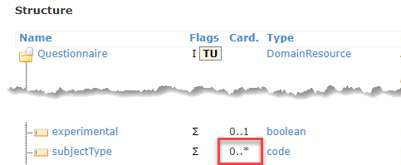
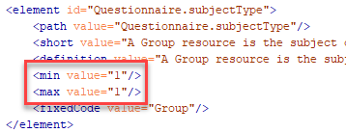
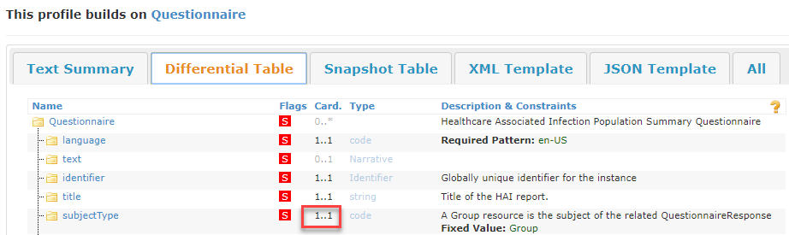
Cardinality
Base Questionnaire resource with zero to many [0..*] subjectType allowed.
StructureDefinition for a profile on Questionnaire – constrains cardinality on subjectType to exactly one [1..1].
Resulting profile in an IG showing constrained cardinality on subjectType.

Slide 12
Terminology Binding
Codes that are allowed for a coded element
Bindings:
Fixed
Single code/system, everything not specified is prohibited (e.g. display is prohibited if not specifically fixed)
Pattern
Single code/system, everything not specified is allowed (e.g. display is allowed to be any value if it is not specifically fixed)
ValueSet
Bind to a ValueSet resource (a list of codes that can be validated)
Binding Strength
Options: required, extensible, preferred, or example

Slide 13
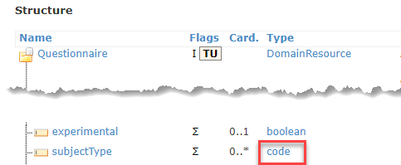
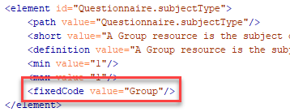
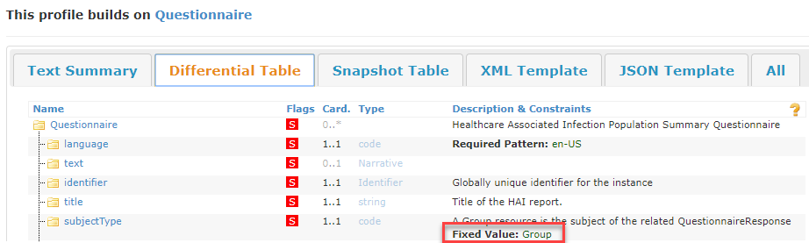
Terminology - Fixed
Base Questionnaire coded element but no terminology specified
StructureDefinition for a profile on Questionnaire – constrains terminology to be a fixed value of “Group”.
Resulting profile in an IG showing constrained terminology on subjectType.

Slide 14
ValueSet binding strength
Binding Strengths
Required – must use a value from specified value set – can’t use any other values
Extensible – if a code for the required concept exists in the value set it must be used – otherwise can use another value
Preferred – recommended (but not required) value set
Example – example value set – not expected to use these values

Slide 15
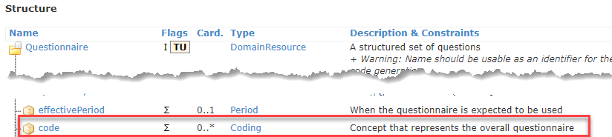
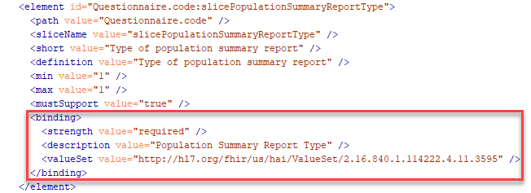
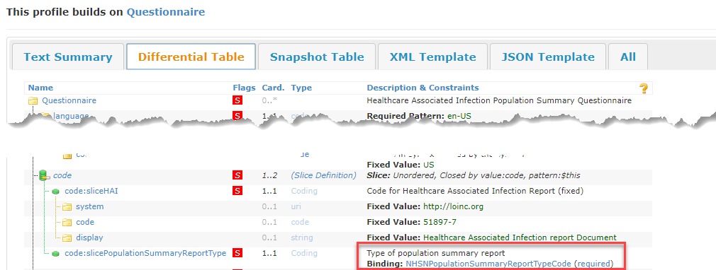
Terminology – Value Sets
Base Questionnaire coded element but no terminology specified
StructureDefinition for a profile on Questionnaire – constrains terminology to a specific value set. Strength of binding is “required” (SHALL use a value from this value set).
Resulting profile in an IG showing constrained terminology on code slice.

Slide 16
Slicing
Take an element that may occur more than once (e.g. in a list), and then split the list into a series of sub-lists, each with different restrictions
Classic example is a blood pressure observation where there are two components – systolic and diastolic
Each component is a “slice”
Each slice has a different, fixed LOINC code to differentiate it from any other component – “systolic” and “diastolic”
A discriminator identifies the slice

Slide 17
Slicing - Discriminator
A discriminator identifies the slice – this is what the system checks to distinguish between multiple slices
Discriminator types:
Value
Exists
Pattern
Type
Profile
Blood pressure example would be “Value” – the system would check the value of the element for “systolic” or “diastolic”

Slide 18
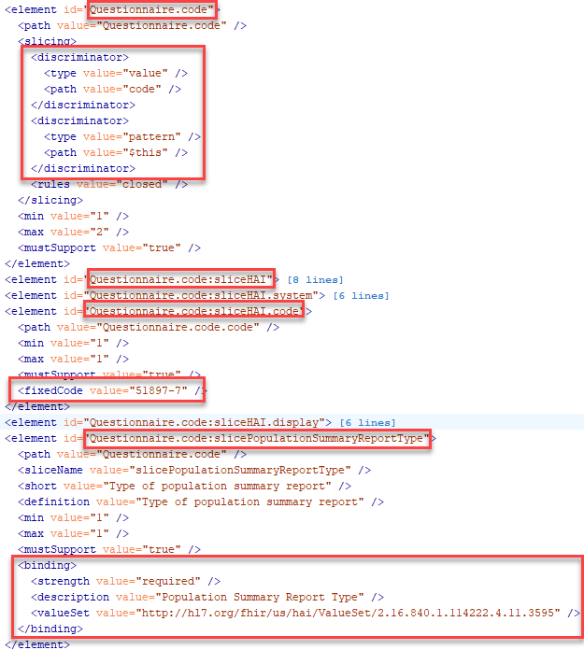
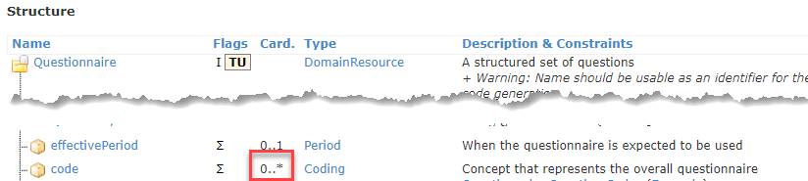
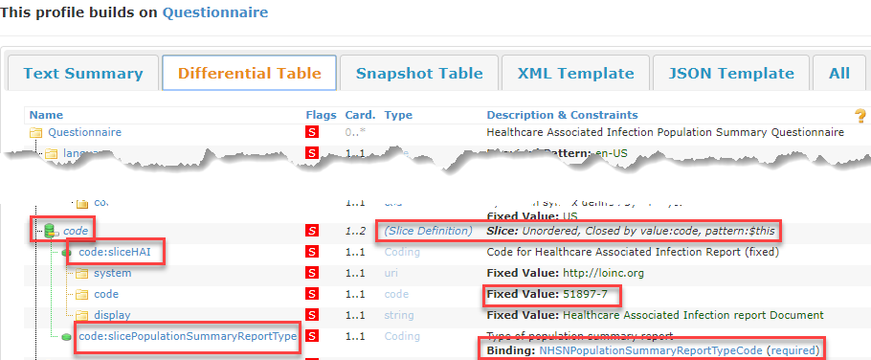
Slicing
Base Questionnaire.code element – multiple allowed
StructureDefinition for a profile on Questionnaire – setting up slicing on Questionnaire.code
Resulting profile in an IG showing slices and discriminators set up on Questionnaire.code

Slide 19
Must Support
Implementers SHALL provide "support" for the element in some meaningful way
Often used for items that we want to require, but for which data sometimes does not exist (e.g. allergies)

Slide 20
StructureDefinition Resource
StructureDefinition Resource the definition of a FHIR structure
Used to define base FHIR resources, data types, extensions, etc.
Describes a structure – a set of data element definitions, and their associated rules of usage

Slide 21
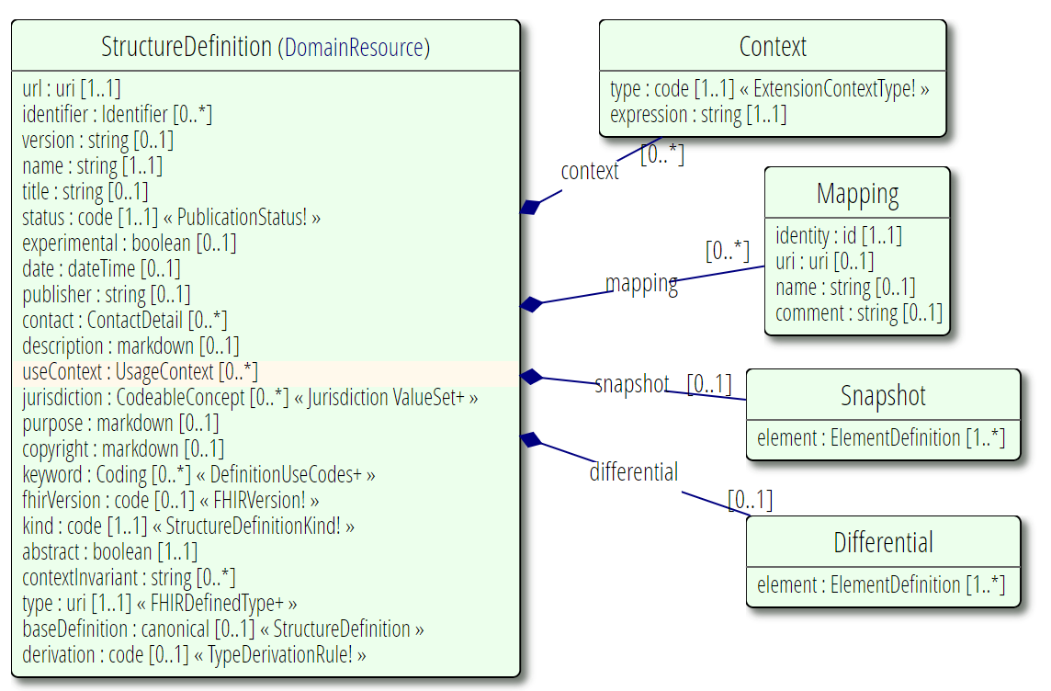
StructureDefinition UML Diagram

Slide 22
Important StructureDefinition Fields
url: Canonical identifier for this structure definition, represented as a URI (globally unique)
name: Name for the structure definition. Should start with a capital and should not contain spaces or special characters (can contain underscores but not dashes). E.g.: “Test_Profile”
title: A short, descriptive, user-friendly title for the structure definition. E.g.: “Test Profile”
description: A free text natural language description of the structure definition from a consumer's perspective.
fhirVersion: The version of the FHIR specification on which this StructureDefinition is based. (e.g. 4.0.0)
type: The resource or datatype constrained by this StructureDefiniton (e.g. “Observation” or “Questionnaire” or “Condition”)
baseDefinition: the base structure from which this one is derived (e.g. http://hl7.org/fhir/StructureDefinition/Condition or http://hl7.org/fhir/us/core/StructureDefinition/us-core-condition )
snapshot: Created automatically by tooling. Defines the “roll up” of all constraints from this profile and any base profiles and resources.
differential: If present, contains one or more ElementDefinition types describing differences from the baseDefinition

Slide 23
StructureDefinition.element
The Snapshot and Differential contain the definition of the structure being defined
Made up of multiple “element” data elements
ElementDefinition data type
includes:
Path (name), Cardinality, and data type
Definitions, usage notes, and requirements
Default or fixed values
Constraints, Length limits, and other usage rules
Terminology Binding
Mappings to other specifications
Structural Usage Information such as Slicing

Slide 24
StructureDefinition.element
StructureDefinition.element (type=ElementDefinition) – important fields:
path: path of the element in the hierarchy (e.g. Communication.topic)
sliceName: name for this particular slice (in a set of slices)
slicing: declares that this element will be sliced and contains the slicing information
short: a short description of the element
definition: the full description of the element
min: the minimum cardinality of the element
max: the maximum cardinality of the element
type: the datatype, resource, or profile of the element
fixed: value must be exactly this
pattern: value of the element must have at least these property values
mustSupport: if the element must be supported
binding: value set binding, if this element is coded

Slide 25
US Core Patient
Live walkthrough of US Core Patient: https://www.hl7.org/fhir/us/core/StructureDefinition-us-core-patient.html

